Slide 1
Getting to the Backdrop
2024-2025
Alachua County Youth Fair
Beef Committee

Slide 2
Beef Committee Members
Beef Chair -Chuck Willis
Beuford Roland
Pam Carter
Brooke Bailey
Jeremy Swilley
Tim Johnson
Fawn Willis
Scott Blackwell
Stacy Donaldson

Slide 3
Picking out a steer
Start looking for a calf in the Spring. (March or April)
Your calf should be an August-October calf from the previous year. Inquire about the projected weight for your calf and frame score.

Slide 4
Look for……
Heavy muscling, growth potential, & balance.
A calf that is good structured and can move well, when set into motion.
A calf that will weigh around 700 pounds at weigh in.
A calf with a good attitude.

Slide 5
Tips
It is recommended that you feed your steer through the summer.
It is also is a good idea to work with your steer over the summer: halter breaking, teaching him to lead, & introducing a show stick.

Slide 6
Where to keep him
Your calf’s enclosure should have free access to water.
Shade
Feed pan/trough
Free access to roughage like grass or hay.

Slide 7
Remember the Goal
Your steer must weigh at least 1,000 pounds at the final weigh in.
His average daily weight gain must be a minimum 2 pounds a day.
Your steer should have at least 3/10”-5/10” back fat to be considered “market ready”.

Slide 8
Tools you need at the Fair
Rope Halter with Neck rope
Pooper scooper
Wheel barrow/cart
Show halter
Show stick
Scotch comb
Large feed pan
Water bucket
Feed for the entire time you’re at the fair
Outdoor Official Dress (boots, black jeans, white shirt, scarf or bow tie)
Health papers
EID tag shall be required at the final weigh in

Slide 9
Also useful
Grooming chute
Blower
Fan
Hose with nozzle
Washing supplies (A brush with soap & water only)

Slide 10
Don’t be afraid to get help
Make sure to use all your resources!
Ask your advisors, breeder, vet, or beef committee members when you have questions.
If there is a problem do not wait until it is out of control, before asking for help.
For example: if your steer stops eating, contact someone within the week instead of waiting until he’s in danger of not making weight.

Slide 11
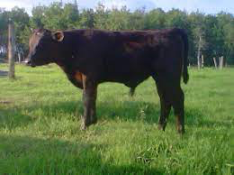
Evaluating
Take a minute and consider these two steers. What are the “pros/cons” of each? Which steer would you choose as your project?
Steer 1 is going to most likely finish out better in the long run.
1
2

Slide 12
Steer 1
Some things to notice:
He is heavy muscled, square out of his hip, and carries his muscling down into his leg
Moderate frame size
Big bellied
Looks to have good structure… good angles to hock and pasterns
Not too high in his flank (most young calves have high flanks, but they drop with feed and when fat starts to deposit into the rear flank)
He has “extras” and is eye appealing (big bone, level top, long neck, clean through dewlap and brisket, and has hair)

Slide 13
Steer 2
Some things to notice:
Flat muscling through his entire rear end
Large frame (meaning he will finish at a much higher weight than a small or moderate calf)
Very high flanked and deep in his brisket, which combined make him look unbalanced
Fine boned

Slide 14
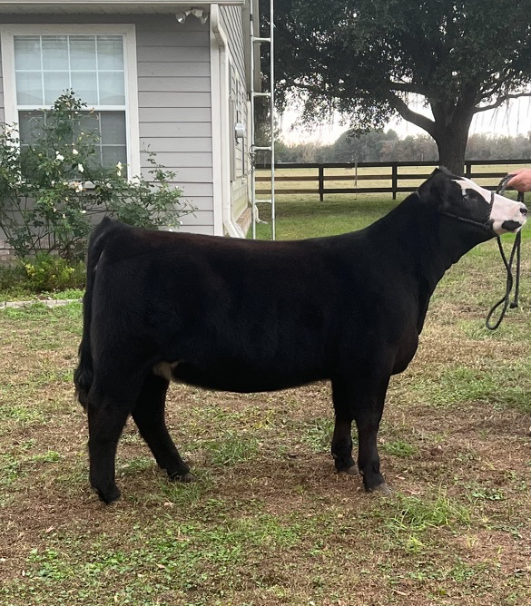
Heifers
Attributes of a quality breeding female
Good structure is the main priority
Deep and bold through the center of their body
Feminine and extended head and neck
Muscling, a wide pin set, and heavy bone are desirable

Slide 15
Changes this year
Entry fees for Steers and Beef Breeding have increased to $25.00.
All Beef Breeding Shows must have a minimum of 10 entries by December 7th or will be canceled.
The Beef Committee/Chair will determine classes by animal ages within the show.

Slide 16
Also….
Because the Youth Fair is a learning platform, beef exhibitors are required to participate in Showmanship and the Cattlemen’s Contest. Study guides are always posted on our website and usually available from your advisors/leaders. Not only will you learn from these experiences but, you gain points towards our All Around Competitions.

Slide 17
Old RULES to know if your going to Show
All beef animal must have a valid Health Certificate from your vet.
All beef animals must be secured by a halter and neck rope when in the beds.
No horned cattle allowed.

Slide 18
CONT-
Exhibitors must be able to handle their animals. Uncontrollable animals are not allowed.
Do your clipping at home. But, if your animals need a touch up, only a registered exhibitor can do it.
All beef animals must be in your possession by the time entry forms are due. (owned & leased animals)

Slide 19
Also
Lease agreements need to be turned in with entry forms.
All bulls have to be registered and if they are older than 12 months, they must be shown with a nose lead.
No slick shearing of steers.

Slide 20
Good Luck
All other rules can be located online at the youth fair website.
Please fill free to reach out if you have questions.

